Slide 1
Correlation between ozone and its precursors
Group 9​

Slide 2
Contents
Introduction​
Data
Data Analysis Methods
Results
​Conclusion​

Slide 3
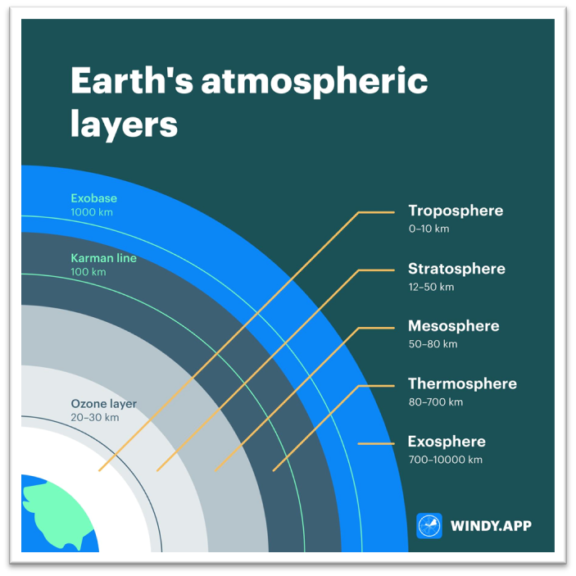
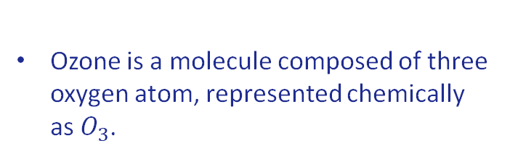
Introduction
Ozone is a molecule composed of three oxygen atom, represented chemically as $O_{3}$.
PRECURSOR
A precursor refer to a substance that, through chemical reaction, contributes to the formation of another compound.
Tropospheric ozone can have adverse effect on human health, causing respiratory issues and other problem.

Slide 4
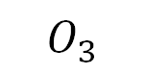


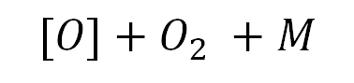
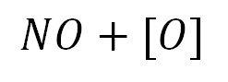
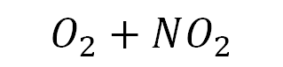
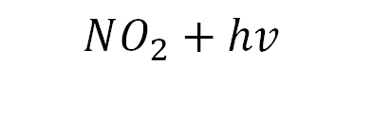

FORMATION OF OZONE
Precursor 1
$$CO+hv$$
$$O_{3}$$
Precursor 2
$$NO_{2}+hv$$
$$NO+[O]$$
$$[O]+O_{2 }+M$$
$$O_{3}+M$$
$O_{3}$ reacts rapidly with NO to regenerate $NO_{2} through$,
$$NO+O_{3}$$
$$O_{2}+NO_{2}$$
The natural concentration of ozone is about 10 parts per billion (0.000001 percent. exposure to ozone levels of greater than 70 parts per billion for 8 hours or longer is unhealthy.

Slide 5
Data
Analysis Techniques

Slide 6
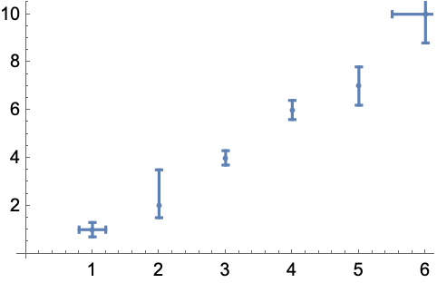
Scatter Plot and Error Bars
A scatter plot is a type of data visualization that displays individual data points on a two-dimensional graph. Each point represents the values of two variables, and the position of the point on the graph is determined by the values of these variables. Scatter plots are used to observe and understand the relationship between two continuous variables.
Error bars are graphical representations of the variability of data and used on graphs to indicate the error or uncertainty in a reported measurement. They give a general idea of how precise a measurement is, or conversely, how far from the reported value the true (error free) value might be.

Slide 7
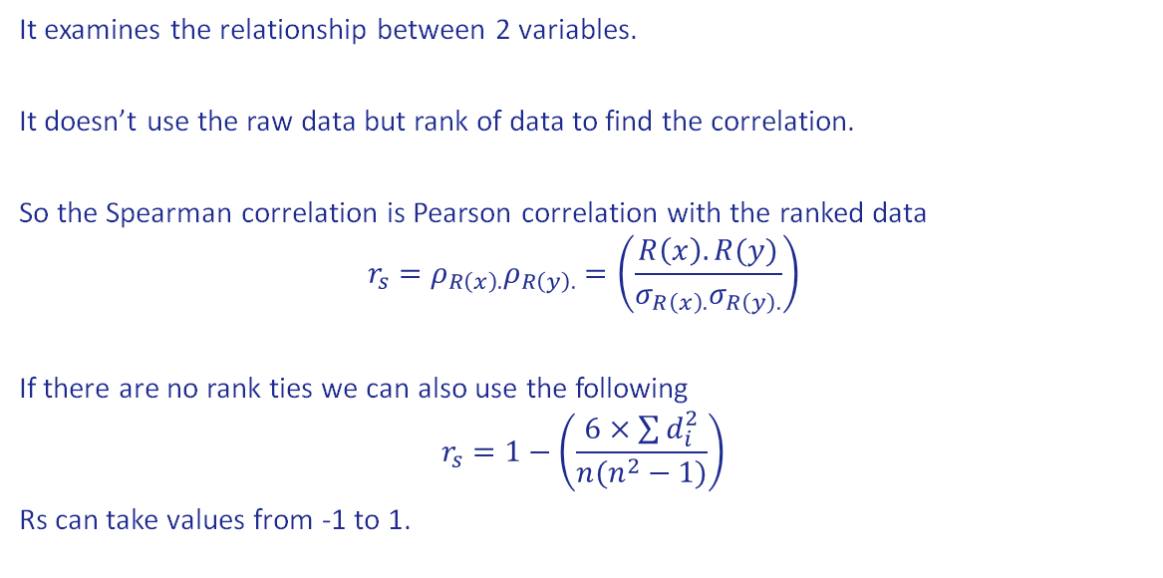
Spearman Correlation Coefficient
It examines the relationship between 2 variables.
It doesn’t use the raw data but rank of data to find the correlation.
So the Spearman correlation is Pearson correlation with the ranked data
$$r_{s}=ρ_{R\left(x\right).}ρ_{R\left(y\right).}=\left(\frac{R\left(x\right). R(y)}{σ_{R\left(x\right).}σ_{R\left(y\right).}}\right)$$
If there are no rank ties we can also use the following
$$r_{s}=1−\left(\frac{6×\sum{d_{i}^{2}}}{n(n^{2}−1)}\right)$$
Rs can take values from -1 to 1.

Slide 8
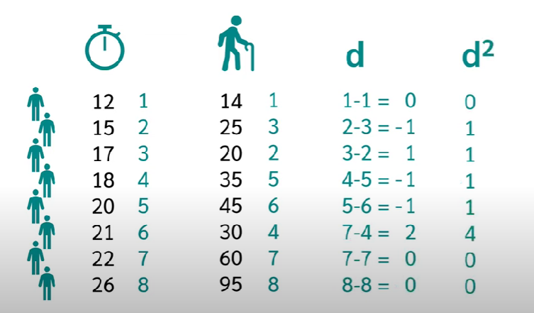
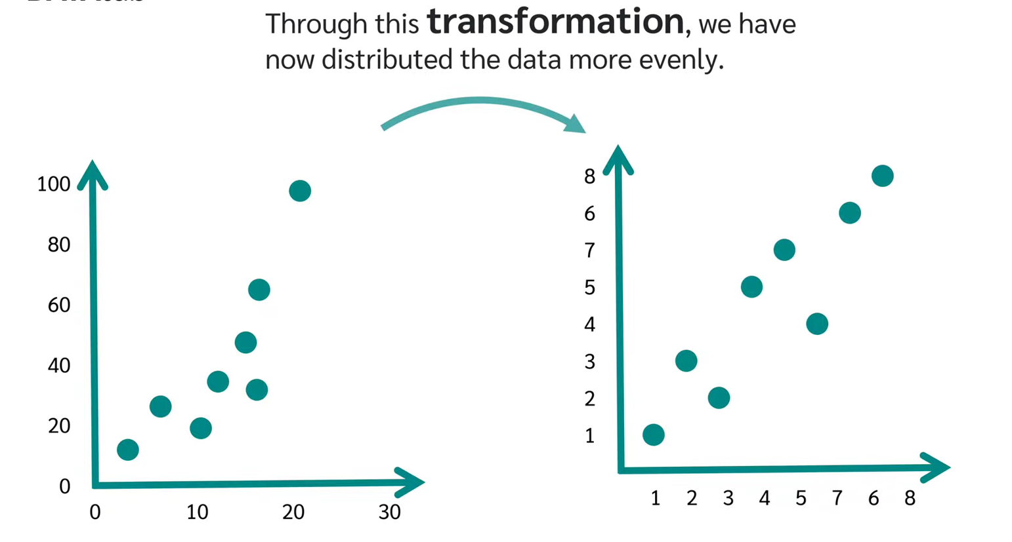
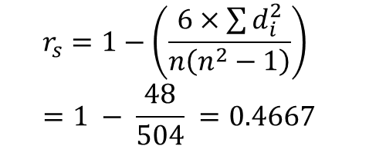
An Example
Let us consider the data between the reaction time and age of the person
$$r_{s}=1−\left(\frac{6×\sum{d_{i}^{2}}}{n\left(n^{2}−1\right)}\right) =1 − \frac{48}{504} =0.4667$$

Slide 9
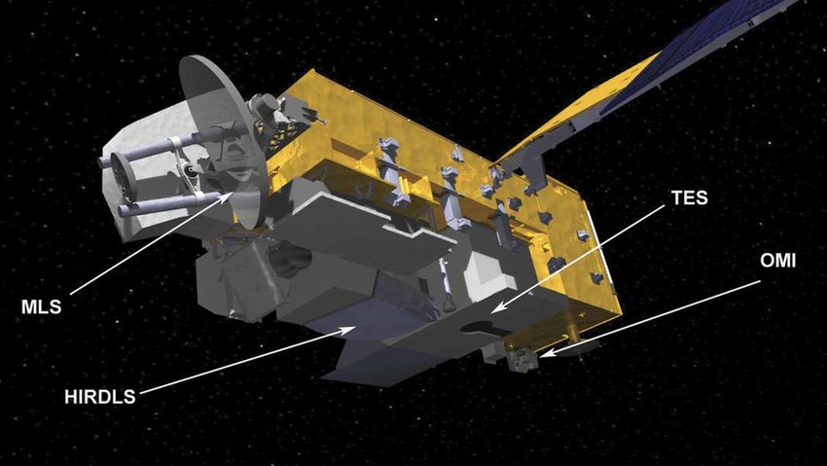
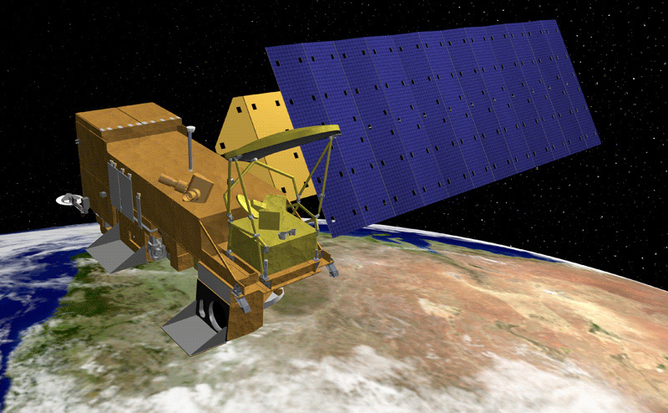
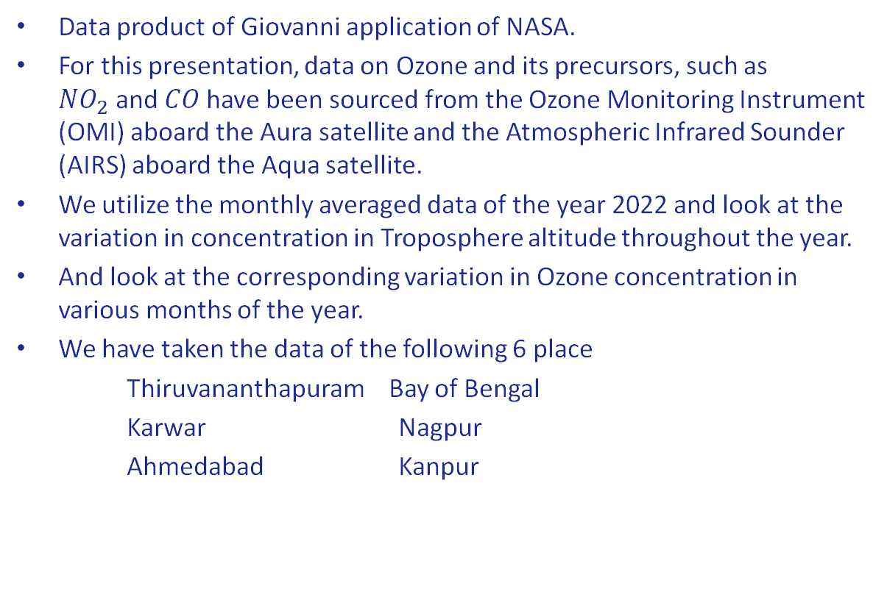
Data Source
Data product of Giovanni application of NASA.
For this presentation, data on Ozone and its precursors, such as $NO_{2}$and $CO$have been sourced from the Ozone Monitoring Instrument (OMI) aboard the Aura satellite and the Atmospheric Infrared Sounder (AIRS) aboard the Aqua satellite.
We utilize the monthly averaged data of the year 2022 and look at the variation in concentration in Troposphere altitude throughout the year.
And look at the corresponding variation in Ozone concentration in various months of the year.
We have taken the data of the following 6 place
Thiruvananthapuram Bay of Bengal
Karwar Nagpur
Ahmedabad Kanpur
Model of the Aura spacecraft
Model of the Aqua spacecraft

Slide 10
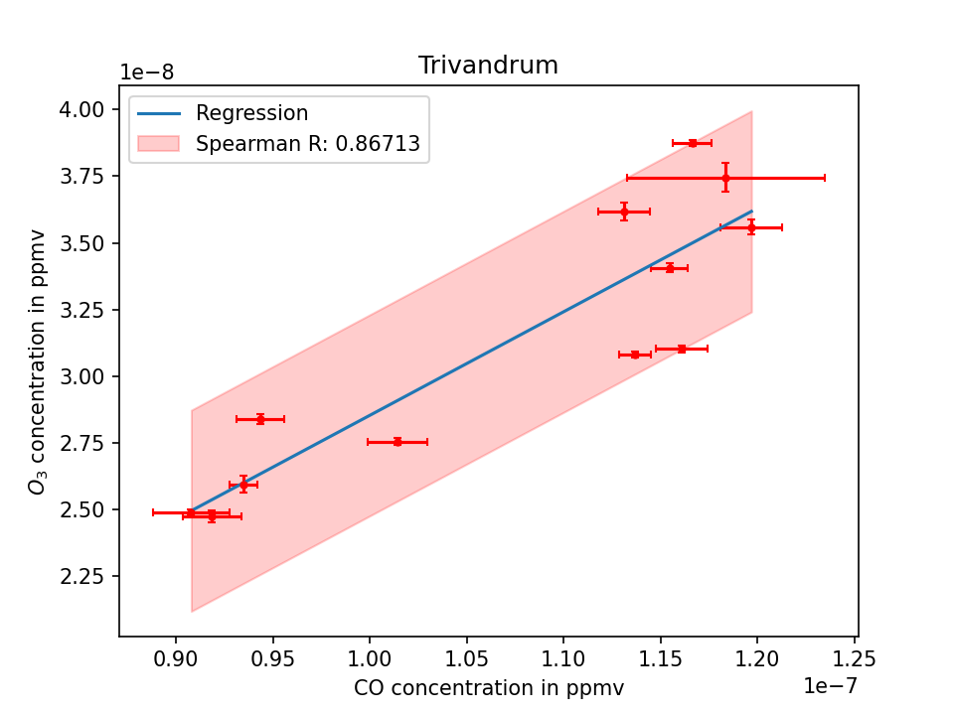
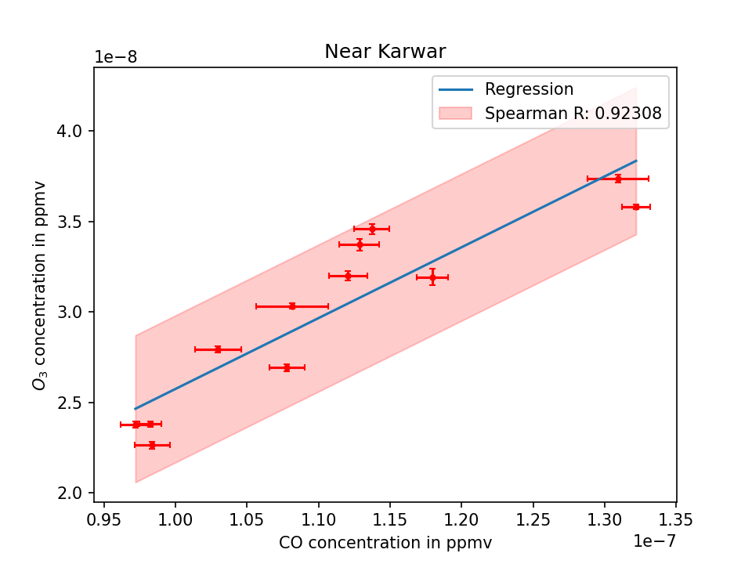
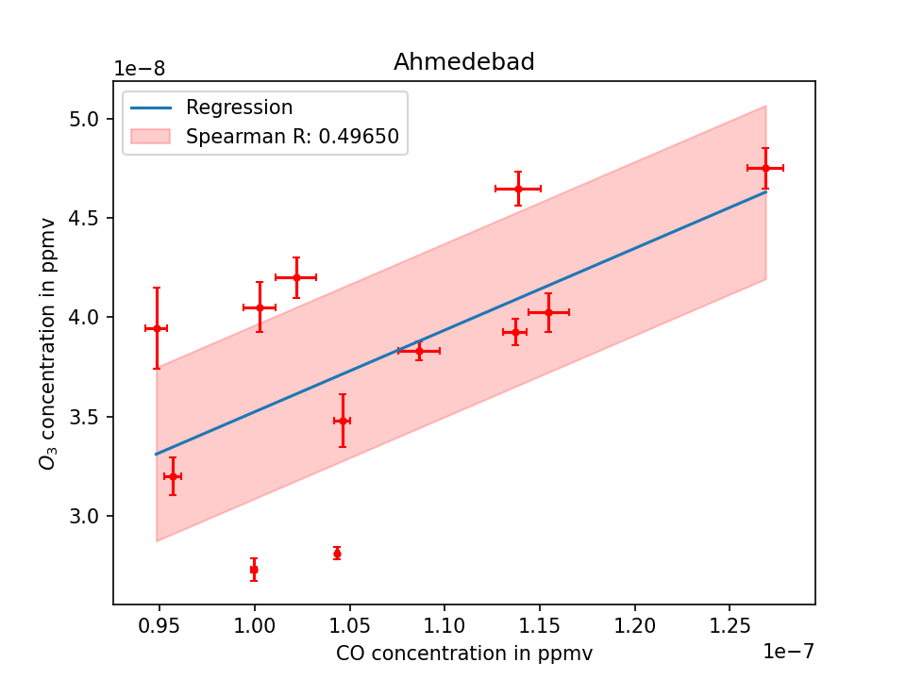
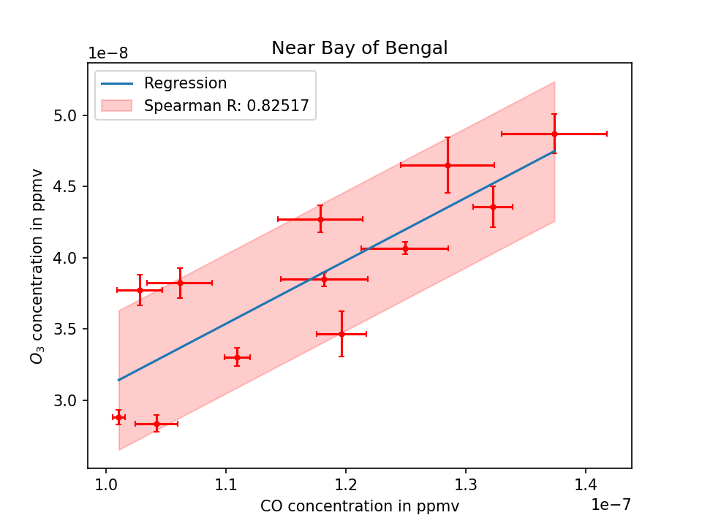
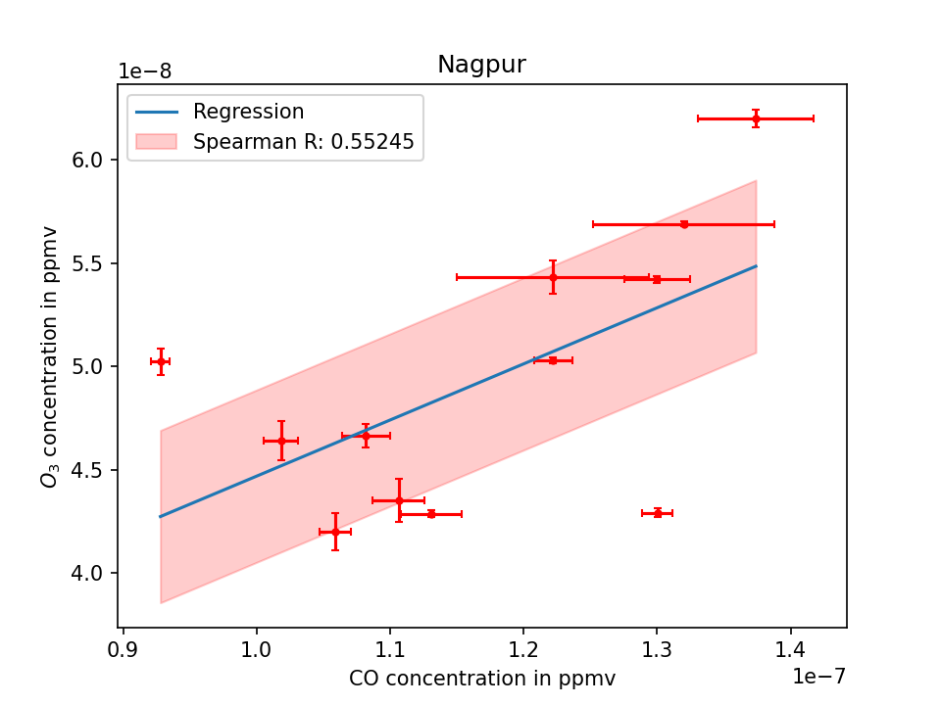
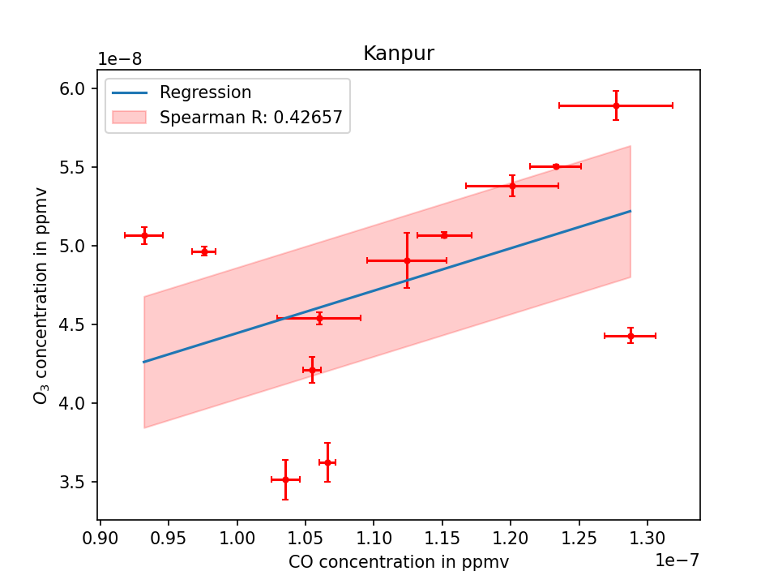
Results: ozone variation with CO

Slide 11
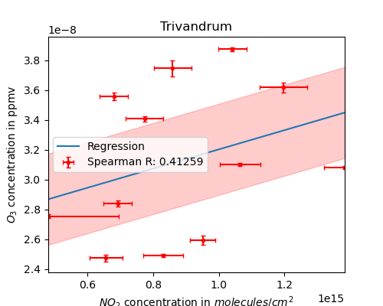
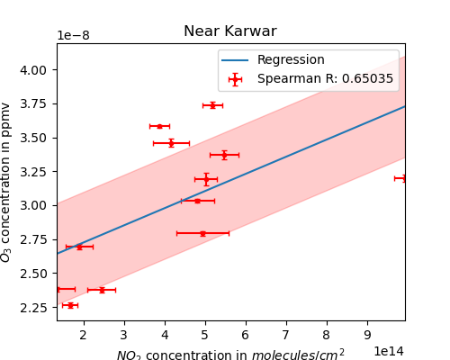
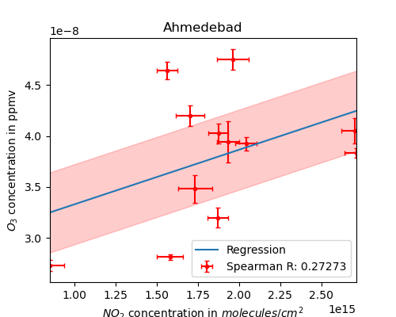
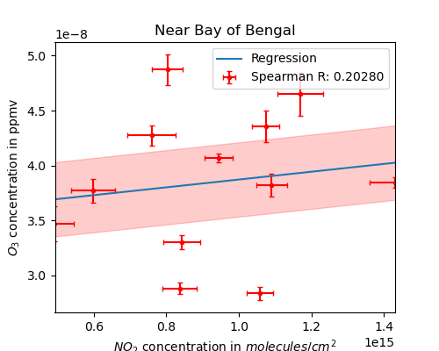
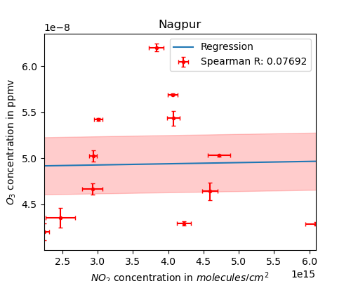
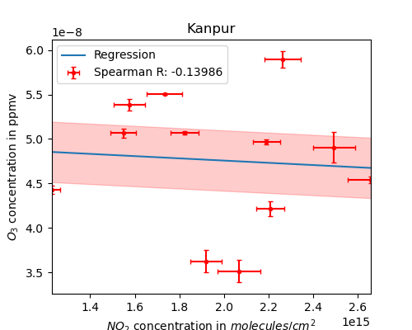
Results: Ozone variation with No₂

Slide 12
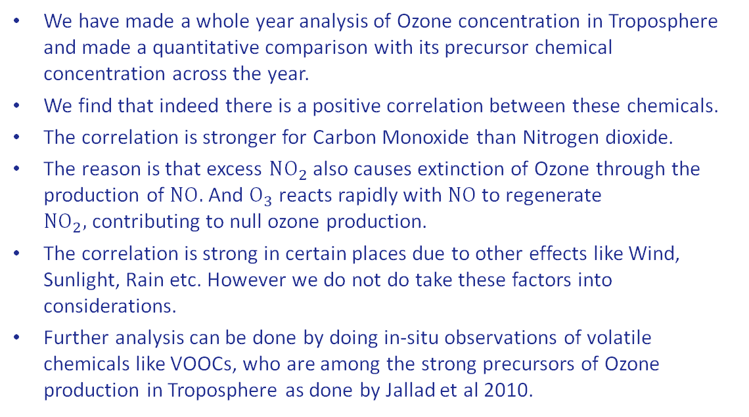
Conclusions
We have made a whole year analysis of Ozone concentration in Troposphere and made a quantitative comparison with its precursor chemical concentration across the year.
We find that indeed there is a positive correlation between these chemicals.
The correlation is stronger for Carbon Monoxide than Nitrogen dioxide.
The reason is that excess $NO_{2}$ also causes extinction of Ozone through the production of $NO.$And $O_{3}$reacts rapidly with $NO$to regenerate ${NO}_{2},$contributing to null ozone production.
The correlation is strong in certain places due to other effects like Wind, Sunlight, Rain etc. However we do not do take these factors into considerations.
Further analysis can be done by doing in-situ observations of volatile chemicals like VOOCs, who are among the strong precursors of Ozone production in Troposphere as done by Jallad et al 2010.

Slide 13

THANK YOU
From left to right
Karthik S B
Patel Nikiben
Vibhor Khanna

Slide 14
References
Karim N Jallad and Cyntia Espada-Jallad. Analysis of ambient ozone and precursor monitoring data in a densely populated residential area of kuwait. Journal of Saudi Chemical Society, 14(4):363–372, 2010.
Jack Fishman and Paul J Crutzen. The origin of ozone in the troposphere. Nature, 274(5674):855–858, 1978
Xiao Lu, Lin Zhang, and Lu Shen. Meteorology and climate influences on tropospheric ozone: a review of natural sources, chemistry, and transport patterns. Current Pollution Reports, 5:238–260, 2019.

Slide 15
